Slide 1

Uncertainty in Postprandial Model Identification in type 1 Diabetes
Alejandro José Laguna Sanz
Supervisors:
Jorge Bondia Company
Paolo Rossetti

Slide 2
Outline
The issue of variability in the treatment of type 1 diabetes: role of an Artificial Pancreas
State of the art: Predicting blood glucose
Objective I: Optimal experiment design
Objective II: CGM Statistical modeling
Objective III: New methods for characterization of variability
Interval identification: proof of concept
In-patient interval identification
Out-patient interval identification
Final conclusions and future work
Notes:
I will start exposing the problem of variability in diabetes
Not repeat T1DM every objective.
Objectives are results

Slide 3
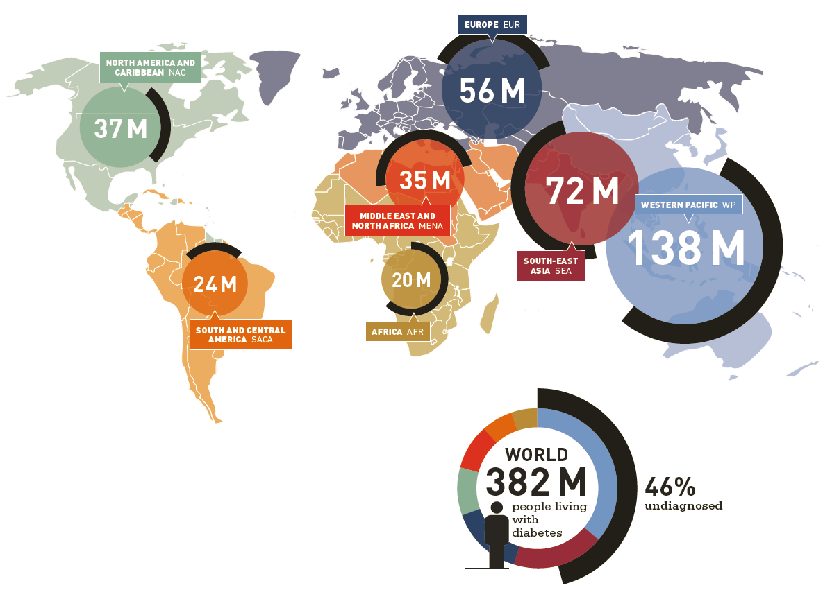
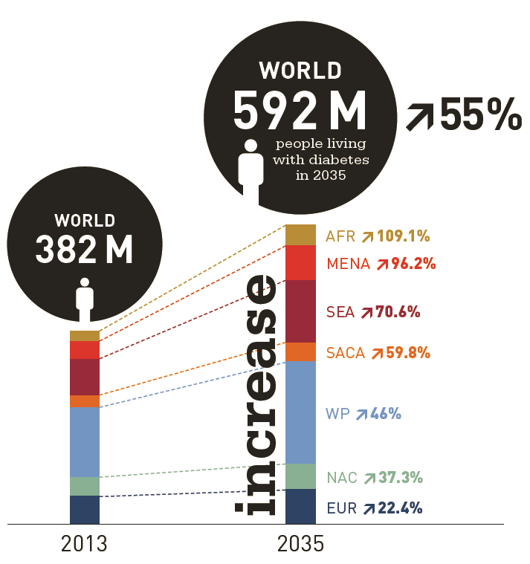
Diabetes
Introduction
State of the art
Objective I
Objective II
Objective III
Conclusions
http://www.idf.org/diabetesatlas
Notes:
10% type 1
The projection into the future is dangerous, but Diabetes nowadays is a real problem

Slide 4
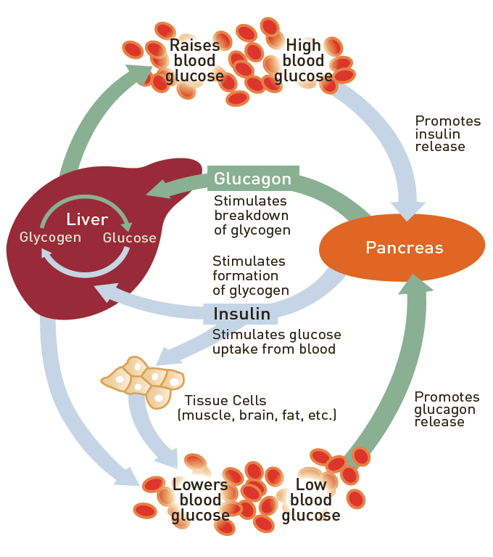
Metabolism
Introduction
State of the art
Objective I
Objective II
Objective III
Conclusions
Insulin and glucagon are the main hormones in charge of glucose homeostasis.
In type 1 diabetic patients, the pancreas insulin secretion is partially or totally absent.
Glucagon function can also be damaged.
External replacement of insulin has been used since its discovery in 1921.
No insulin treatment to date has achieved glucose control objectives.
http://www.idf.org/diabetesatlas
Notes:
Pancreas is the main control agent in glucose homeostasis.
Click again for the cross over the pancreas.
Click again for highlighting the last sentence.

Slide 5
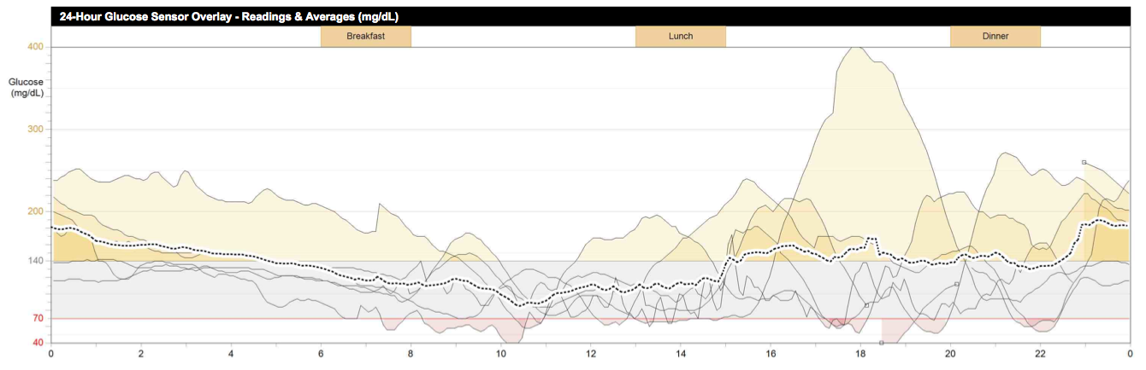
Variability in diabetes
Introduction
State of the art
Objective I
Objective II
Objective III
Conclusions
Inter-patient (population) variability
Intra-patient variability
Overlapping glucose profiles of 7 days of the same diabetic patient.
Notes:
Explain regions of glucose and safety concerns on the patient: Hypo Eu & Hyperglycemia. Over 140 mg/dl is hyperglycemia

Slide 6

How to deal with variability
Introduction
State of the art
Objective I
Objective II
Objective III
Conclusions
Closed loop: Emulation of physiological natural response of the pancreas
Disturbance
Safety constraints
Meal
Actuator
Control Algorithm
Insulin delivery
Patient
Glucose
Glucose sensor
Notes:
“Sensoring” is not a word
When speaking of the disturbances, introduce that the problem we focus here is the postprandial period.

Slide 7
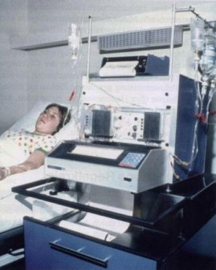
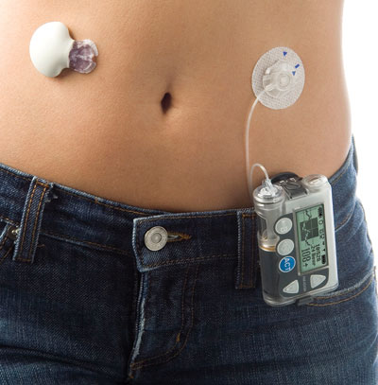
Technology
Introduction
State of the art
Objective I
Objective II
Objective III
Conclusions
Natural pancreatic control in a healthy person
Biostator: The first closed loop device for diabetes
Current state of technology involves continuous glucose measurements and insulin infusion
No delay involved: Insulin secretion takes place in blood and directly in the portal system.
Glucose is “measured” in blood.
Insulin is delivered in blood, but in the peripheral system
Glucose is measured in blood.
Only valid for hospital environment.
Insulin is delivered subcutaneously.
Glucose is indirectly measured in the subcutaneous tissue.
Valid in home conditions.
Great delays and uncertainties involved.

Slide 8
Motivation
Introduction
State of the art
Objective I
Objective II
Objective III
Conclusions
Selection of tools for characterizing variability in glucose profiles of type 1 diabetes
1st Obtaining richer information from patient’s monitoring.
2nd Characterizing the error in CGM since it may jeopardize variability identification.
3rd Glucose model individualization including variability.

Slide 9
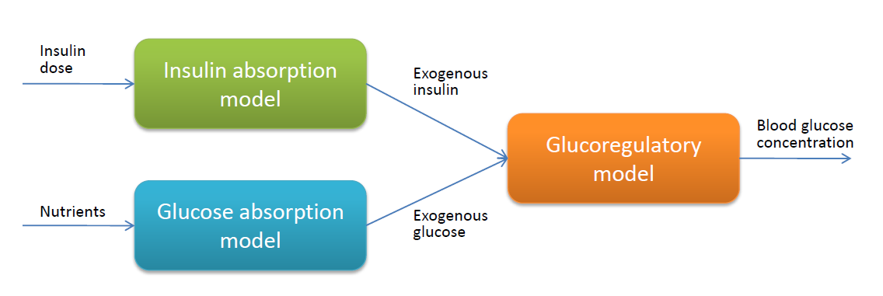
Models
Introduction
State of the art
Objective I
Objective II
Objective III
Conclusions
Modified Panunzi¹
model
Bergman model²
Minimal models
Used for optimal experiment design
Average complexity models
Cambridge model³
UVA model⁴
Used for characterization of patients and variability
1 Panunzi et al. (2007) Theoretical Biology and Medical Modelling,
2 Bergman et al. (1981) Journalof Clinical Investigation
3 Hovorka et al. (2002) Am J Physiol-Endoc M.
4 Kovatchev et al. (2009) J Diab Sci Technol.
Notes:
Cambridge i UVA son models aplicats a simuladors de pacients virtuals
Resposta a pq Cambridge i no UVA: Mateixa Complexitat, tots dos validats poblacionalment, tots dos aplicats a bucle tancat. Raons pràctiques.

Slide 10
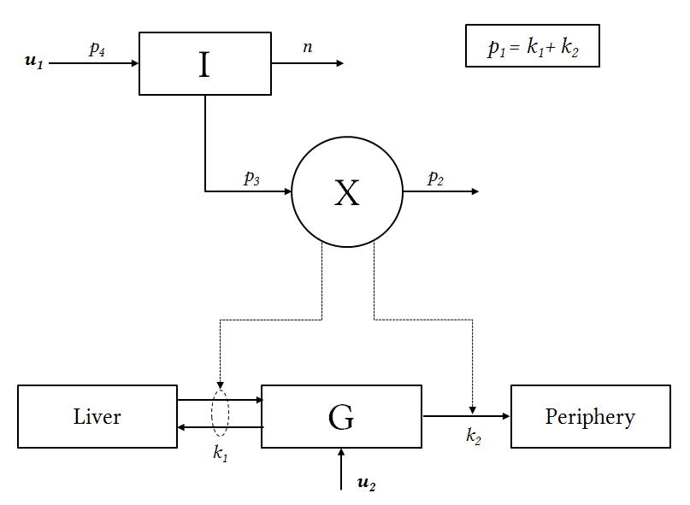
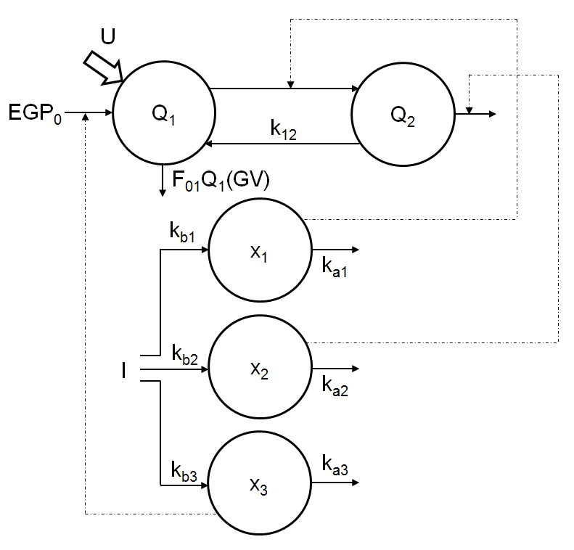
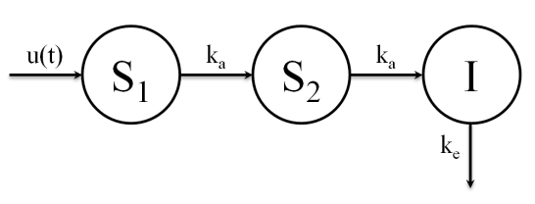
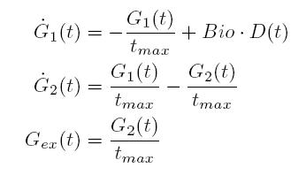
As illustration…
Introduction
State of the art
Objective I
Objective II
Objective III
Conclusions
Minimal models (Bergman)
Average complexity models (Cambridge)
2 state equations + input systems
4 parameters + input parameters
5 state equations + input systems
12 parameters + input parameters
Less computational cost
More physiologically accurate
Bergman et al. (1981) Journal of Clinical Investigation
Hovorka et al. (2002) Am J Physiol-Endoc M.

Slide 11
Identification Experiments
Introduction
State of the art
Objective I
Objective II
Objective III
Conclusions
Experiment | Type of model | Pros | Cons
Ståhl @ Sweden¹ | Data based | Real life measurements Up to two hour prediction | Data from only one individual
Cescon @ Sweden² | Data based | Use of CGM data | Data from only one individual 30 minutes prediction
Rollins @ USA³ | Data based | Use of multiple sensors Successful fit R=0.7 | Data from only one individual Absence of insulin disturbance
Georga @ Greece⁴ | Data based | 7 patients dataset | Poor predictions
Cameron @ USA⁵ | Data based | Experimental validation of the identifications | Poor predictions
Palerm @ USA⁶ | First principles | Good data fitting Physiology based models | Validation not satisfactory
Finan @ USA⁷ | Data based | Comparison against ZOH | No improvement over ZOH
Kirchsteiger @ Germany⁸ | Data based | Interval usage (uncertainty consideration) | No validation of the identifications performed
1 Ståhl & Johansson (2009) Mathematical Biosciences 217(2):107-117
Only one experiment in literature was performed using first principles model
2 Cescon et al. (2009) Insulin 2(4):6
3 Rollins et al. (2010) Journal of Process Control 20(1):95-107
Few experiments were performed on more than 1 patient
4 Georga et al. (2011) Knowledge Oriented Applications in Data Mining
5 Cameron et al. (2012) Journal of Process Control 22(8):1422-1432
Poor predictions, or non prediction at all were reported
6 Palerm et al. (2006) EMBS Annual Conference
7 Finan et al. (2009) Journal of Diabetes Science and Technology 4(1):4-14
8 Kirchsteiger et al. (2011) IFAC World Congress 18:11761-11766
Notes:
Donar entrada a la següent transparencia sobre l’assaig the kirchsteiger

Slide 12
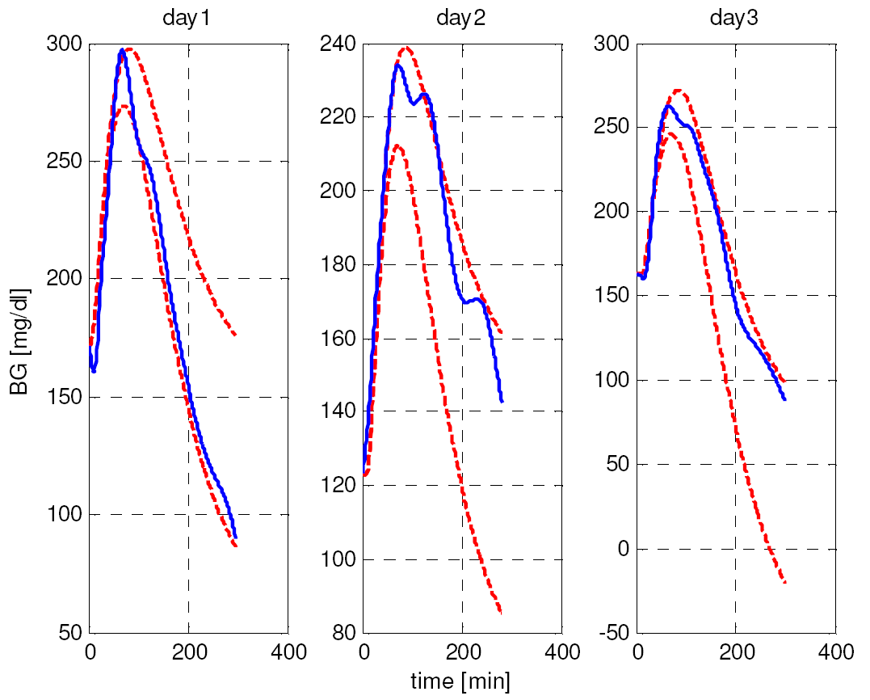
Interval identification
Introduction
State of the art
Objective I
Objective II
Objective III
Conclusions
Kirchsteiger experiment was published in 2011, in the IFAC world conference in Milan.
General transfer function models were used. 1 model per day and minimizing the standard deviation of the identified parameters.
This method yields intervals parameters.
Data are not guaranteed to be enclosed.
Validation of the results is not performed with the identified interval parameters.
No validation statistics are reported.

Slide 13
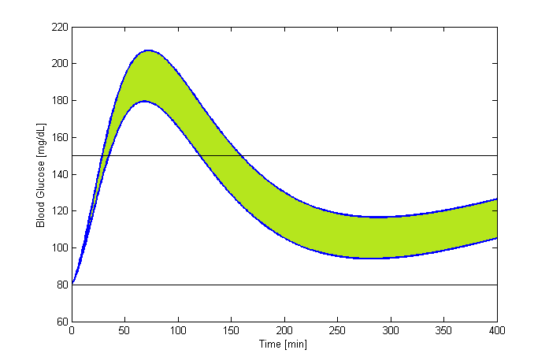
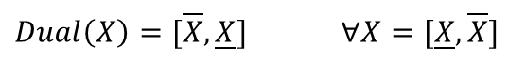
Interval models
Introduction
State of the art
Objective I
Objective II
Objective III
Conclusions
Solution is a band of possible glucose values.
Guaranteed envelope of traditional simulations.
Efficient computation.
Literature available interval models of type 1 diabetic patients:
Calm et al. published an interval approach of the Cambridge model using modal interval analysis¹.
De Pereda et al. also published a Cambridge model interval solution² using monotonicity analysis.
$$Y\left(t+1\right)=f\left(t,X,P\right), where X∈𝕏, P∈ℙ$$
$$Q_{1}(t+1)=\left(1−Δt\left(k_{12}+x_{1}\left(t\right)\right)\right)Q_{1}(t)−Δt({Dual(F}_{01}^{c}(t))+Dual(F_{R}(t)))+Δtk_{12}S(t)+ΔtB(t)$$
$Dual\left(X\right)=[\overline{X},\underline{X}]$ $∀X=[\underline{X},\overline{X}]$
1 Calm et al. (2010) Journal of Clinical Investigation
2 Hovorka et al. (2002) Am J Physiol-Endoc M.
Notes:
Només mencionar les equacions

Slide 14
Optimal experiment design
Introduction
State of the art
Objective I
Objective II
Objective III
Conclusions
The objective is to design a clinical protocol for optimal patient identification.
Identifiability of two endogenous models was optimized.
Modified Panunzi model.
Bergman model.
Initial parameter set was reduced by means of an identifiability analysis.
D-optimality of the FIM was chosen as identifiability optimum.
Optimization was performed using SSM¹ for Matlab.
Glucose
 | Upper bound | Lower Bound
Meal (gr) | 100 | 0
Bolus (IU) | 10 | 0
τ (minutes) | 300 | -60
Glucose | 250 | 70
Insulin
Bolus delay
bolus
Meal
1 M. Rodriguez-Fernandez et al. (2006) BMC bioinformatics, 7(1):483
Notes:
Note that more parameters does not necessarily mean better identifiability

Slide 15
Optimal Design
Introduction
State of the art
Objective I
Objective II
Objective III
Conclusions
Bergman | τ (minutes) | Bolus (IU) | Meal (gr)
Day 1 | 26.43 | 10 | 85.6
Day 2 | -30.44 | 10 | 100
Day 3 | -30.71 | 10 | 100
Modified Panunzi | τ (minutes) | Bolus (IU) | Meal (gr)
Day 1 | 165.74 | 3.01 | 44.38
Day 2 | -17.83 | 10 | 100
Day 3 | -18.42 | 10 | 100
Experiments are optimized by separating the input excitations.
3 days is optimal for maximizing identifiability and for practical reasons:
1 day delayed bolus – small meal.
2 days bolus in advance – large meal.
Every parameter’s identifiability is improved.
Qualitative results can be extracted.
Published in Laguna et al. (2010) Proceedings of the UKACC international conference
Notes:
Mencionar que els resultats del disseny d’experiments es va publicar al UKACC l’any 2010

Slide 16
Protocol
Introduction
State of the art
Objective I
Objective II
Objective III
Conclusions
Pre-prandial state | Mixed meal therapy
Glucose over 150 mg/dL or Glucose between 100 and 150 mg/dL and rising | Bolus insulin in advance 30 minutes separation 100g meal
Glucose below 100 mg/dL or Glucose between 100 and 150 mg/dL and decreasing | Delayed insulin bolus 120 minutes separation 40g meal
150 mg/dL
100 mg/dL
30 min
Insulin bolus time
Meal time
150 mg/dL
100 mg/dL
120 min
Meal time
Insulin bolus time
Published in Rossetti et al. (2012) Diabetes Technology & Therapeutics
Notes:
Amb aquest protocol minimitzem el risc per al pacient diabetic

Slide 17
Dataset
Introduction
State of the art
Objective I
Objective II
Objective III
Conclusions
Two weeks of home monitoring of 12 patients was performed using the designed protocol.
Only CGM measurements were registered, along with patient’s diary of diet and events.
The data obtained were used in a proof of concept experiment of an open loop control in the Hospital Clínic Universitari de València. The treatment delivered was calculated from models obtained from the monitoring in the previous weeks, which followed the protocol.
Feasibility of the use of models was demonstrated obtaining no worse results than an optimally adjusted therapy.
However, limitations in the models used motivated further research.
Two weeks monitored with CGM at home
Treatment calculated according to the CGM monitoring
Treatment validation in hospital
In-hospital monitoring days did not follow the protocol, but blood glucose, CGM signal and plasma insulin were registered.
12 patients, with four postprandial periods each were monitored.
Published in Rossetti et al. (2012) Diabetes Technology & Therapeutics

Slide 18
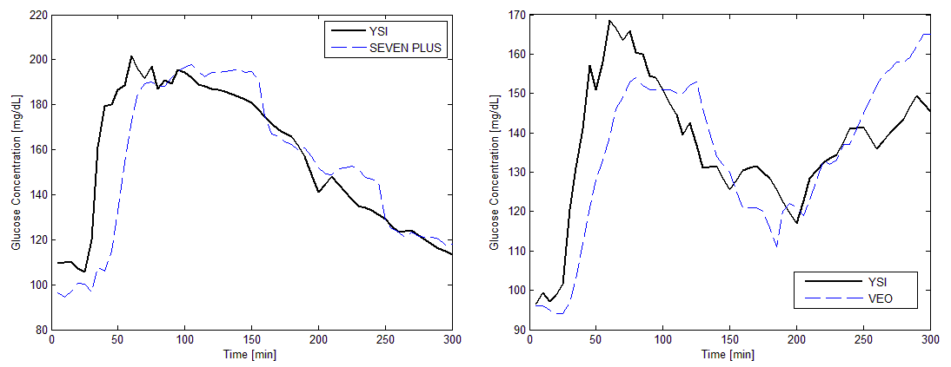
CGM error model
Introduction
State of the art
Objective I
Objective II
Objective III
Conclusions
Two different commercial devices were used simultaneously:
Medtronic Paradigm VEO
Dexcom SEVEN PLUS
The error of these monitors is usually large (average of 20%) and involves delays, biases and time-correlations

Slide 19
CGM error model
Introduction
State of the art
Objective I
Objective II
Objective III
Conclusions
Time delay
Stationarity
Mean error related to the YSI signal gradient
Distribution
AR model fitting of the signal
Time-Correlation
Leptokurtic statistical distribution fitting
Delay calculated out of the maximum cross-correlation between the YSI and the CGM
Error standard deviation related to the YSI signal
Four distributions: Normal, Log-normal, Weibull, Logistic
Stationary signal in mean and standard deviation
Shifted signal without delay
Published in Laguna et al. (2013a) Biomedical Signal Processing & Control
Notes:
Els resultats de tot el modelat dels CGM han estat publicats al Biomedical Signals processing & control

Slide 20

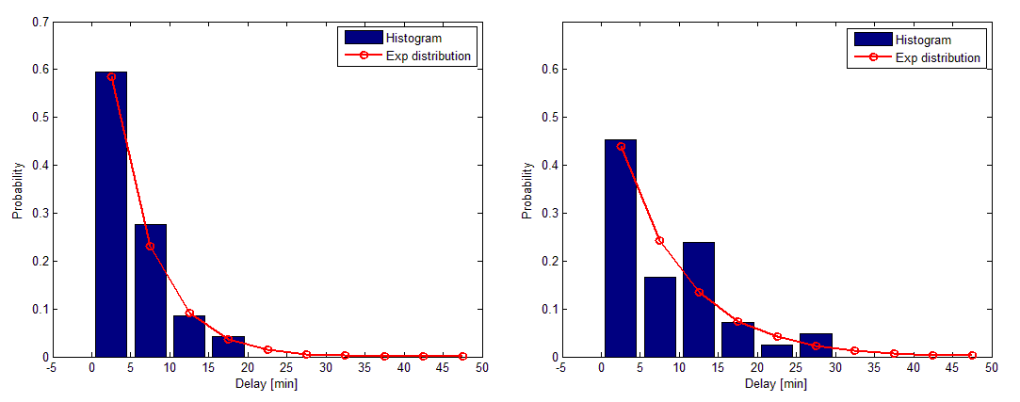
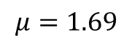
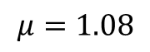
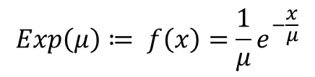
Delay analysis
Introduction
State of the art
Objective I
Objective II
Objective III
Conclusions
$$Exp\left(μ\right)≔ f\left(x\right)=\frac{1}{μ}e^{−\frac{x}{μ}}$$
SEVEN PLUS
VEO
$$μ=1.08$$
$$μ=1.69$$

Slide 21
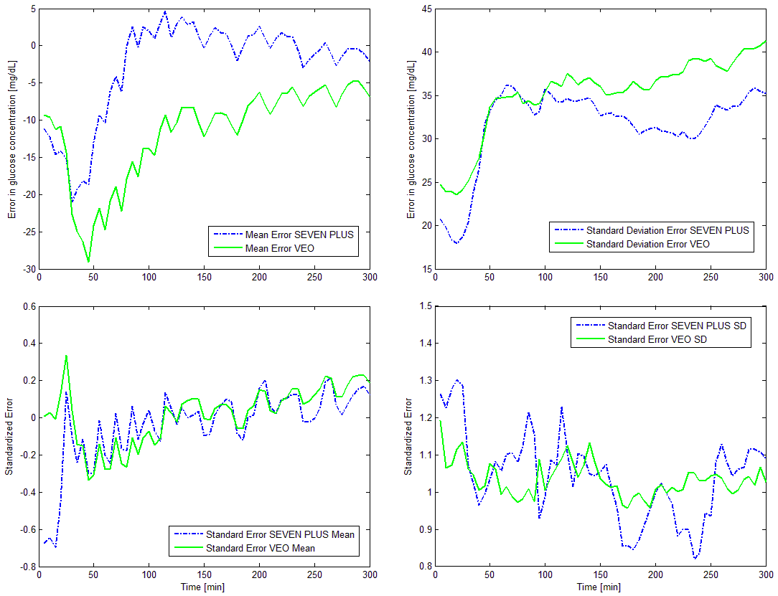
Stationarity
Introduction
State of the art
Objective I
Objective II
Objective III
Conclusions
Pseudo-stationarity of the signal was achieved.
Mean and Standard deviation were modeled and transformed from the blood glucose signal.
The transformation is invertible for simulation purposes.

Slide 22
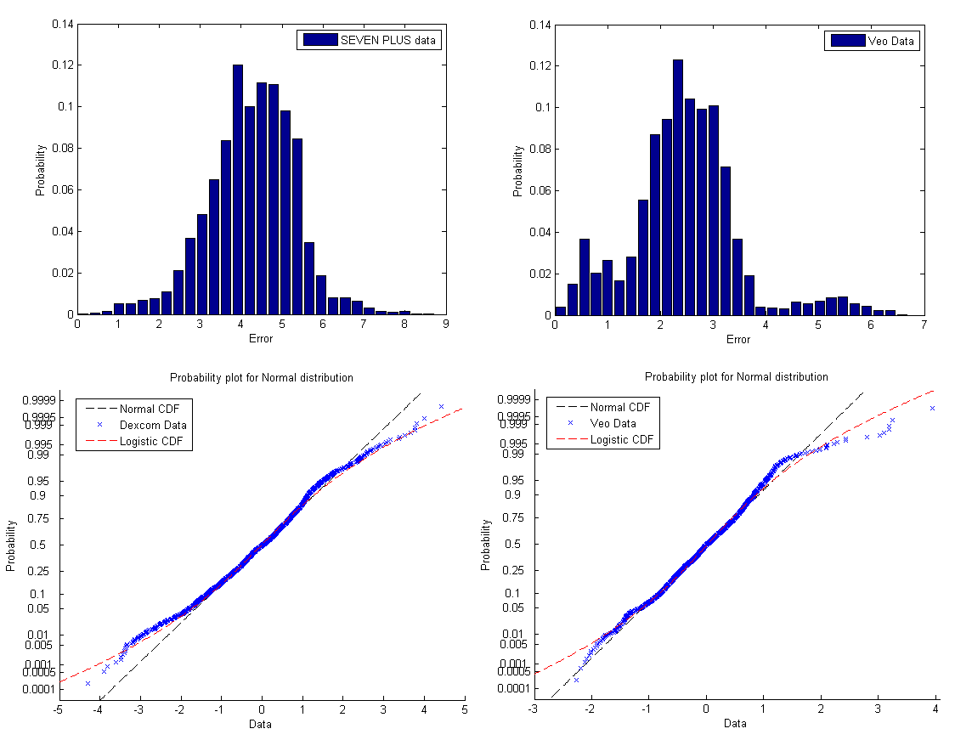
CGM distribution
Introduction
State of the art
Objective I
Objective II
Objective III
Conclusions
Probability distributions and AR models were adjusted to the transformed signal.
Experimental MARD and simulated MARD were very similar (18.72% vs 17.28%) for the SEVEN PLUS monitor.
VEO monitor simulated MARD was somewhat larger than the observed (18.38% vs 14.98%).

Slide 23
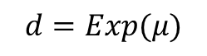
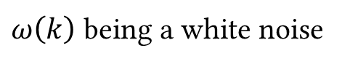
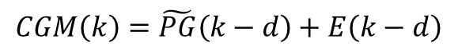
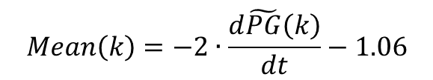
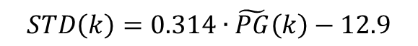
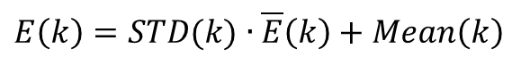
CGM model
Introduction
State of the art
Objective I
Objective II
Objective III
Conclusions
A model was developed for each CGM device analyzed.
The same structure was used for both models.
AR model
$\overline{E}\left(k\right)=α_{1}∙\left(k−1\right)+β∙ω\left(k\right), \overline{E}\left(0\right)=$ $ω(0)$
$ω\left(k\right)$ being a white noise
$$STD\left(k\right)=0.314∙\tilde{PG}\left(k\right)−12.9$$
Non-stationarity
$$Mean\left(k\right)=−2∙\frac{d\tilde{PG}\left(k\right)}{dt}−1.06$$
$E\left(k\right)=STD(k)$ $∙$ $\overline{E}\left(k\right)+Mean\left(k\right)$
Delay
$$d=Exp(μ)$$
$$CGM\left(k\right)=\tilde{PG}\left(k−d\right)+E\left(k−d\right)$$

Slide 24
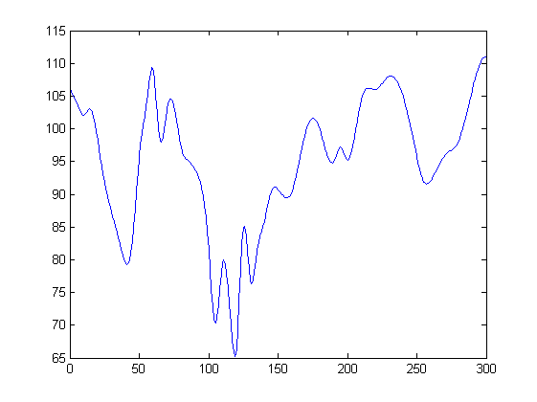
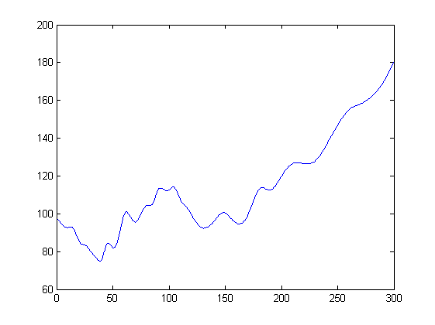
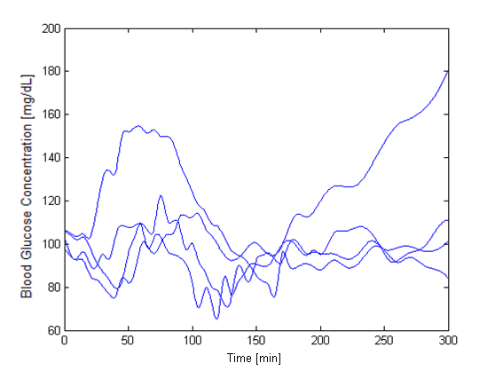
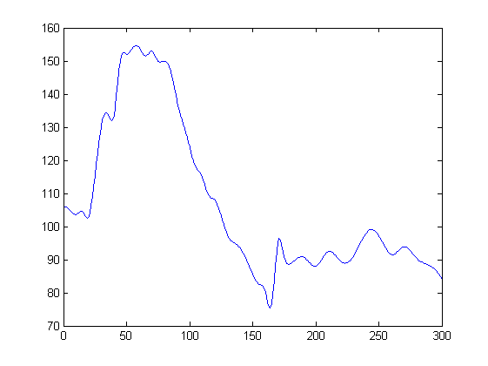
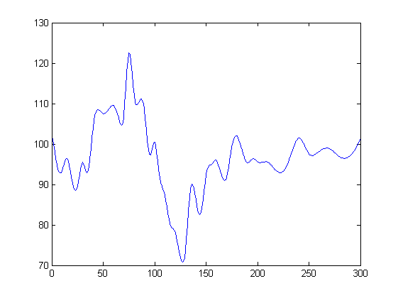
Interval Identification
Introduction
State of the art
Objective I
Objective II
Objective III
Conclusions
interval
classic

Slide 25
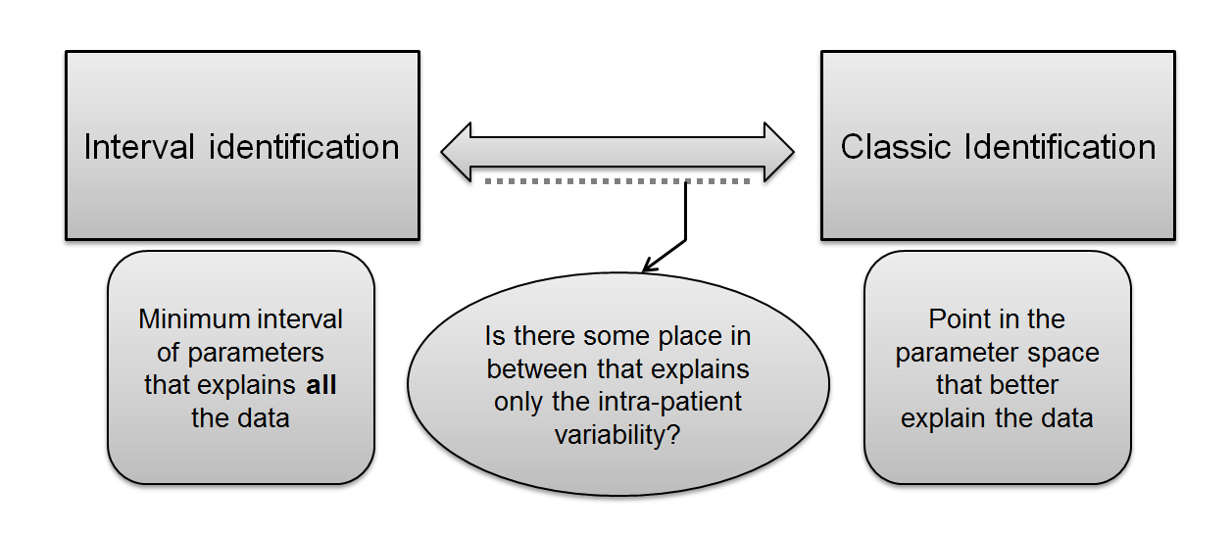
Interval – Classic identification spectrum
Introduction
State of the art
Objective I
Objective II
Objective III
Conclusions
Identification procedure:
All calculations were performed in Matlab R2012a.
Multi-objective optimization was performed using the εv-MOGA¹ optimization algorithm.
1 Herrero et al. (2007) Computational and Ambient Intelligence
Notes:
Relacionar la decisió amb el CGM i els errors de modelat

Slide 26
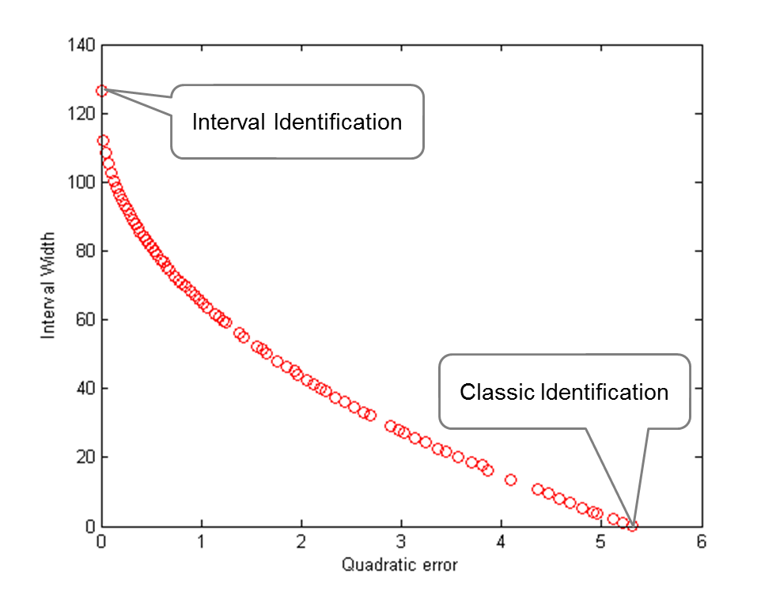
Pareto Front
Introduction
State of the art
Objective I
Objective II
Objective III
Conclusions
Multiple objectives:
J_{e}= Quadratic error to the interval
J_{w}= Interval width
Notes:
La identificació clàsica te error màxim perque es impossible que la curva pase per tots els punts.

Slide 27
Complexity
Introduction
Objective I
Objective II
Objective III
Conclusions
Preface
Part I
Part II
Part III: Interval Identification
Conclusions
State of the art
Less complex
More complex
Virtual data identification
Experimental identification
Using YSI (I)
Using CGM model (II)
Using YSI
Using CGM (V)
Plasma Insulin as input (III)
Including SC Insulin model (IV)
Notes:
Explicar els nombres com a referencies futures

Slide 28
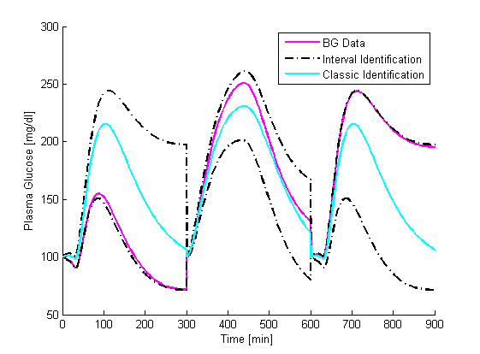
I - Virtual YSI Identification
Introduction
State of the art
Objective I
Objective II
Objective III
Conclusions
14 virtual patients were generated, simulating 3 postprandial periods each
10% uncertainty introduced in insulin sensitivity and insulin elimination.
Postprandial width
Mean | 62,59 (±20,85)
Max | 95,64 (±32,92)
Proof of concept.
100% of samples predicted.
Published in Laguna et al. (2012) In BMS symposium
Notes:
Proba de concepte de la metodologia
Aqueste proves foren publicades al symposium BMS al 2012

Slide 29
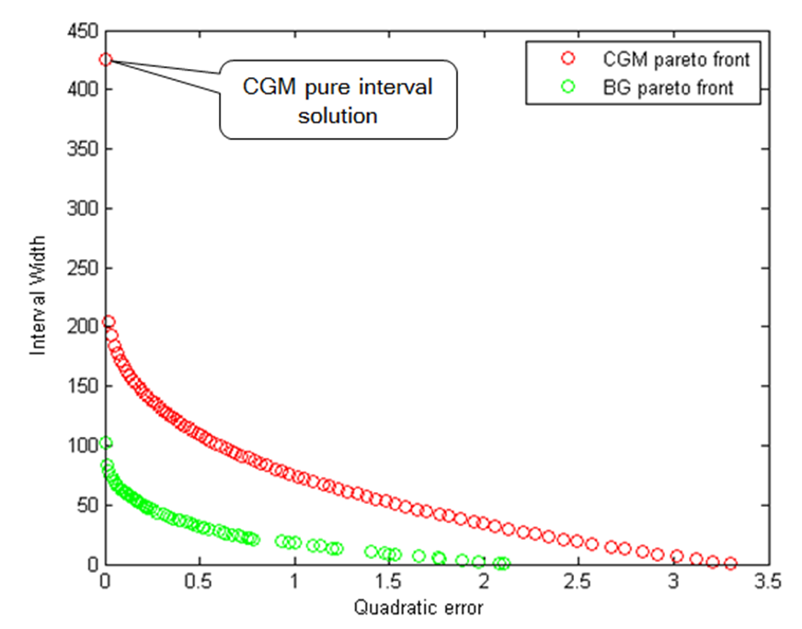
II - CGM Pareto front
Introduction
State of the art
Objective I
Objective II
Objective III
Conclusions

Slide 30
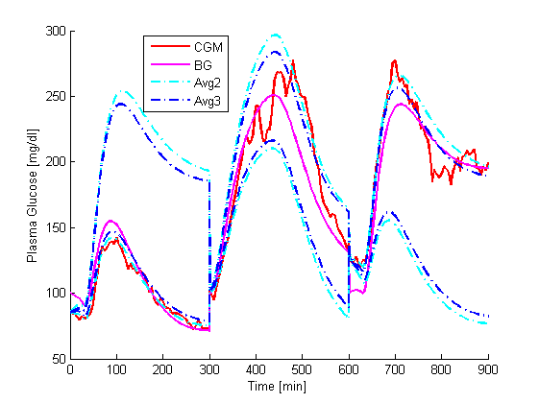
II - Virtual CGM Identification
Introduction
State of the art
Objective I
Objective II
Objective III
Conclusions
Avg2 uses the average width of the superposition of two identical days. Best correlation to variability R=0.83.
Avg3 uses the average width of the superposition of the three monitoring days. Best correlation to variability R=0.8.
Both estimators use linear regression to estimate the envelope width.
Nearest Pareto individual is chosen as the solution.
Validation values | Width [mg/dL] | MARD [%]
Avg2 (median) | 83.3 | 3.3
Avg3 (median) | 61.4 | 4.6
Published in Laguna et al. (2013b) Biomedical Signal Processing & Control
Notes:
Aquestes proves foren publicades al journal Biomedical signal processing & control al 2013

Slide 31
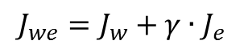
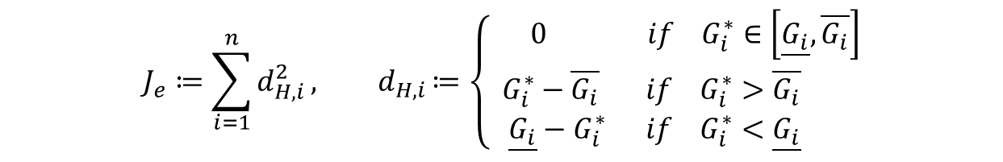
III - Optimization index
Introduction
State of the art
Objective I
Objective II
Objective III
Conclusions
Postprandial data from 12 T1DM patients was used. Four postprandial periods of five hours were available from each patient.
Plasma insulin, plasma glucose and CGM signal were recorded frequently.
$$J_{w}=\max_{i}\left(width\left(G_{i}\right)\right){=\max_{i}\left|\overline{G_{i}}−\underline{G_{i}}\right|}$$
$$J_{e}≔\sum_{i=1}^{n}{d_{H,i}^{2}}{, d}_{H,i}≔\left\{\begin{aligned} 0 if{ G}_{i}^{∗}∈\left[\underline{G_{i}},\overline{G_{i}}\right] \\ G_{i}^{∗}−\overline{G_{i}} if{ G}_{i}^{∗}>\overline{G_{i}} \\ \underline{G_{i}}−G_{i}^{∗} if{ G}_{i}^{∗}<\underline{G_{i}} \end{aligned}\right.$$
$$J_{we}=J_{w}+γ∙J_{e}$$
Optimization with a compound objective yields a single individual of the Pareto front.
Cross-validation of the identifications is performed using a leave-1-day-out strategy.
Plasma insulin was initially considered an input to the system, ignoring the subcutaneous insulin model identification.
Optimization was performed using CMAES¹ global search engine.
1 Hansen et al. (2004) Parallel Problem Solving from Nature-PPSN VIII
Notes:
Introduir la correlació creuada

Slide 32
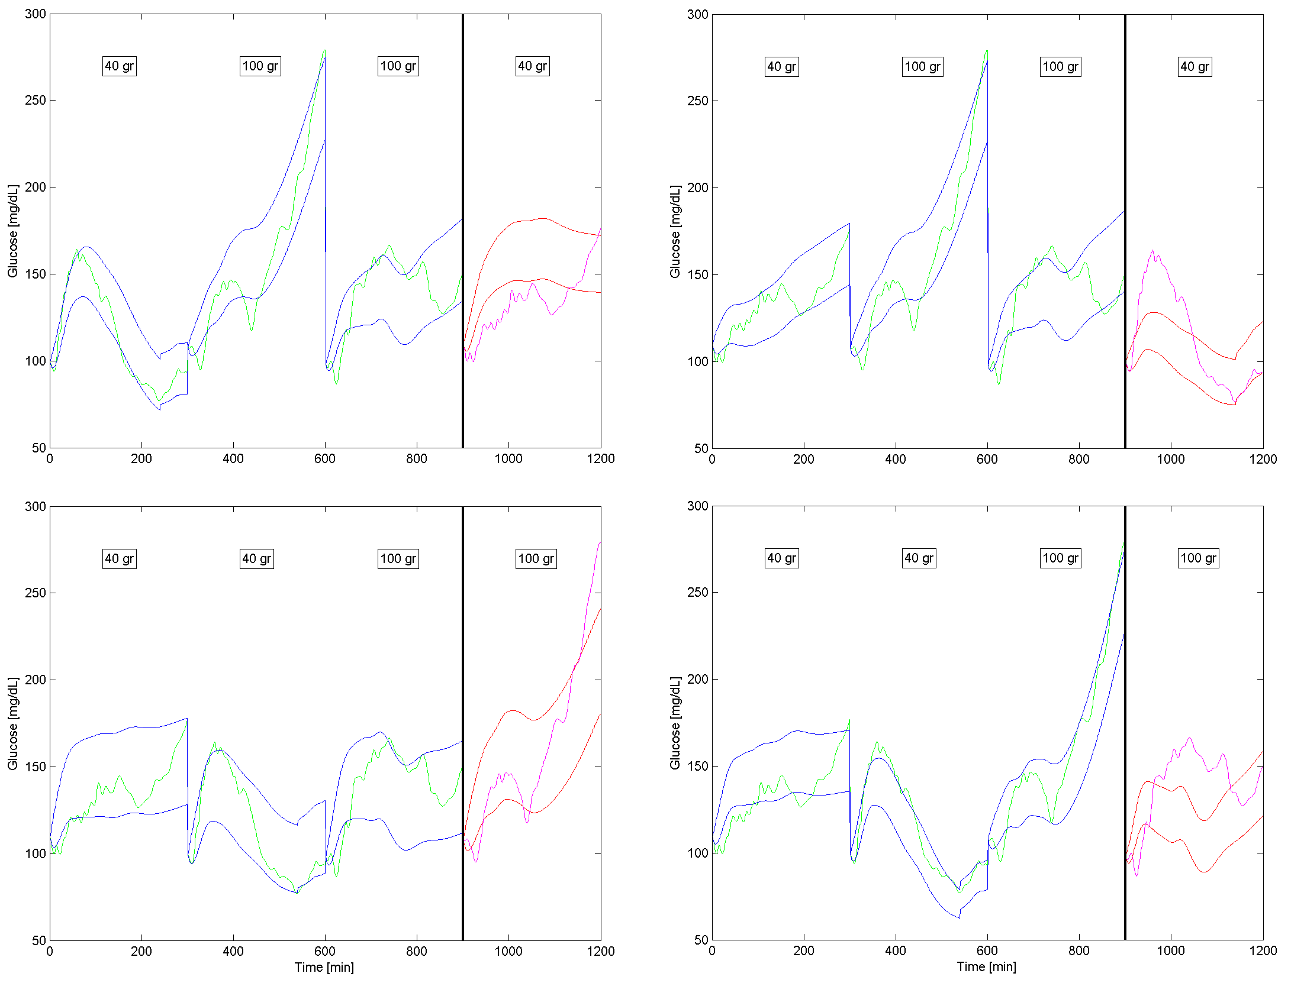
III - YSI Identification
Introduction
State of the art
Objective I
Objective II
Objective III
Conclusions
Patient 2
Published in Laguna et al. (2013) Journal of Process Control

Slide 33
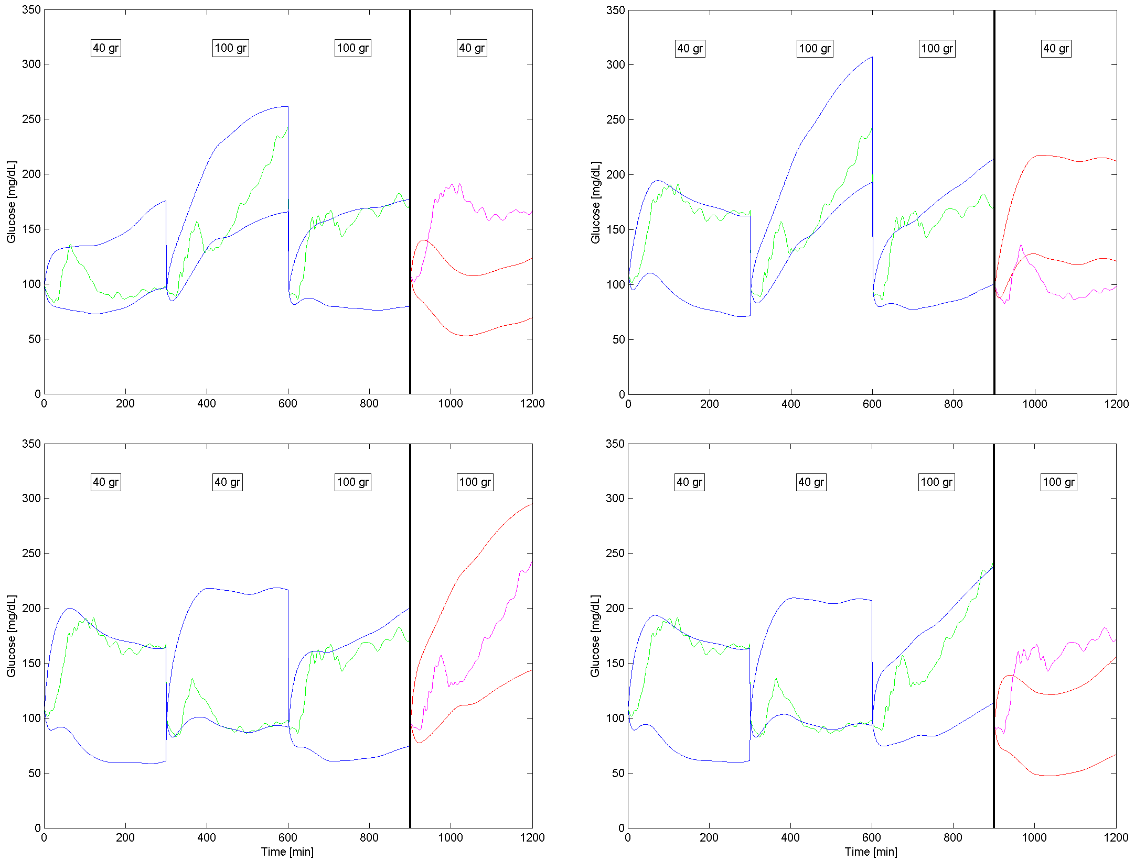
III - YSI Identification
Introduction
State of the art
Objective I
Objective II
Objective III
Conclusions
Patient 11

Slide 34
III - YSI Identification
Introduction
State of the art
Objective I
Objective II
Objective III
Conclusions
 | Width [mg/dL] | Prediction [%] | MARD [%]
Validation set | 66.4 | 52.8 | 5.56
Best case set | 94.3 | 97.3 | 0.03
Best case set is smaller (12) than the total validation set (48).
The differences displayed are statistically significant.
It is expected of larger widths to achieve better predictions.
In order to discard trivial solutions, the larger widths exhibited by the best cases have to be dedicated to simulate intra-patient variability.
If the interval fit of the identification days is not well adjusted, the identified width may be overestimated.
Notes:
Introduir la posibilitat de sobreestimació en l’amplaria

Slide 35
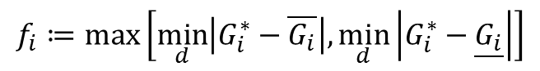
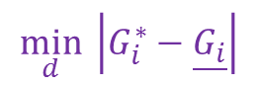
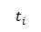
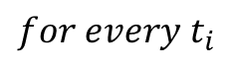
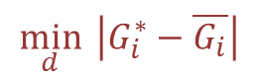

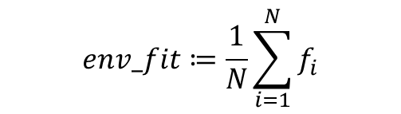
III - Envelope Fitness
Introduction
State of the art
Objective I
Objective II
Objective III
Conclusions
$$\min_{d}{ \left|G_{i}^{∗}−\underline{G_{i}}\right|}$$
$$\min_{d}{ \left|G_{i}^{∗}−\overline{G_{i}}\right|}$$
$$\max\left[\min_{d}\left|G_{i}^{∗}−\overline{G_{i}}\right|,\min_{d}\left|G_{i}^{∗}−\underline{G_{i}}\right|\right]$$
100 mg/dL
$$for every t_{i}$$
$$f_{i}≔\max\left[\min_{d}\left|G_{i}^{∗}−\overline{G_{i}}\right|,\min_{d}\left|G_{i}^{∗}−\underline{G_{i}}\right|\right]$$
$$env_fit≔\frac{1}{N}\sum_{i=1}^{N}{f_{i}}$$
100 mg/dL
Even though width for the best case permutation were larger, envelope fitness was not, suggesting that best case is actually the largest variability displayed by the patient.
100 mg/dL
$$t_{i}$$
Notes:
Donat un lot de 3 periodes postprandials
Destacar que aquest index pot ser aplicat a qualsevol set de dades que es devideix en lots.
No dir que es dificil d’explicar. Es complexe, i matematicament s’explica amb aquestes equacions

Slide 36
III - YSI Identification
Introduction
State of the art
Objective I
Objective II
Objective III
Conclusions
 | Width [mg/dL] | Prediction [%] | MARD [%] | Envelope Fitness [mg/dL]
Validation set | 66.4 | 52.8 | 5.56 | 14.59
Best case set | 94.3 | 97.3 | 0.03 | 15.55
Best case set is smaller (12) than the total validation set (48).
The differences displayed are statistically significant.
It is expected of larger widths to achieve better predictions.
In order to discard trivial solutions, the larger widths exhibited by the best cases have to be dedicated to simulate intra-patient variability.
If the interval fit of the identification days is not well adjusted, the identified width may be overestimated.
Notes:
Introduir la posibilitat de sobreestimació en l’amplaria

Slide 37
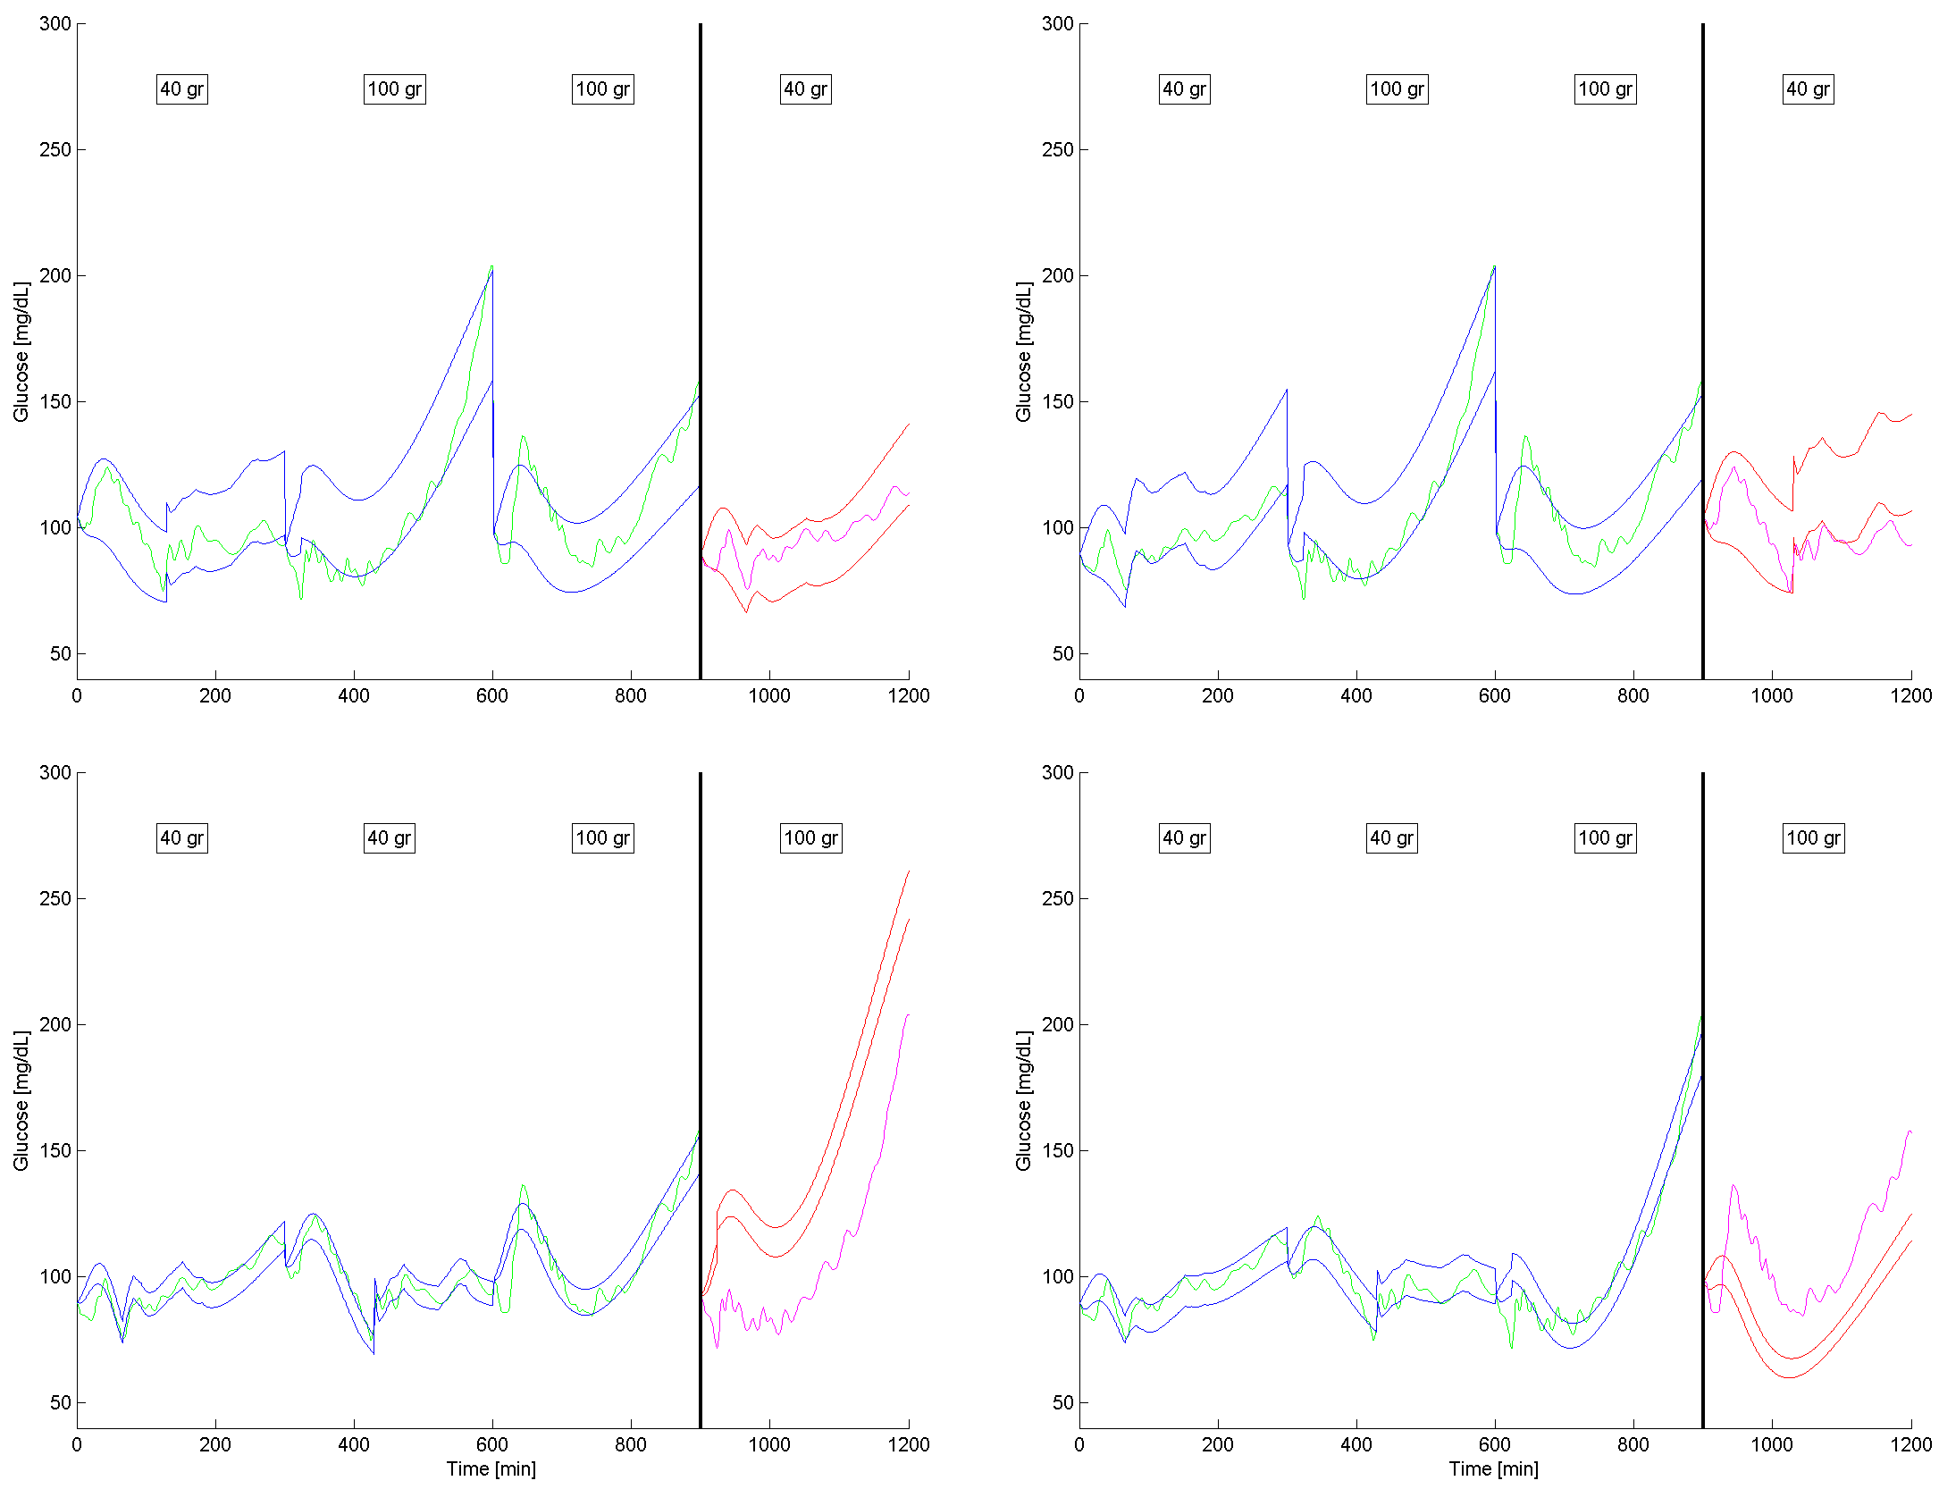
IV - YSI^{ScIns} Identification
Introduction
State of the art
Objective I
Objective II
Objective III
Conclusions
Patient 6

Slide 38
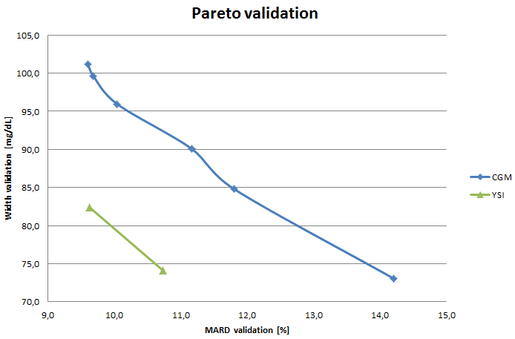
V - Experimental CGM Pareto front
Introduction
State of the art
Objective I
Objective II
Objective III
Conclusions
Notes:
Cada punt d’aquests fronts de Pareto s’ha obtés amb una gamma distinta

Slide 39
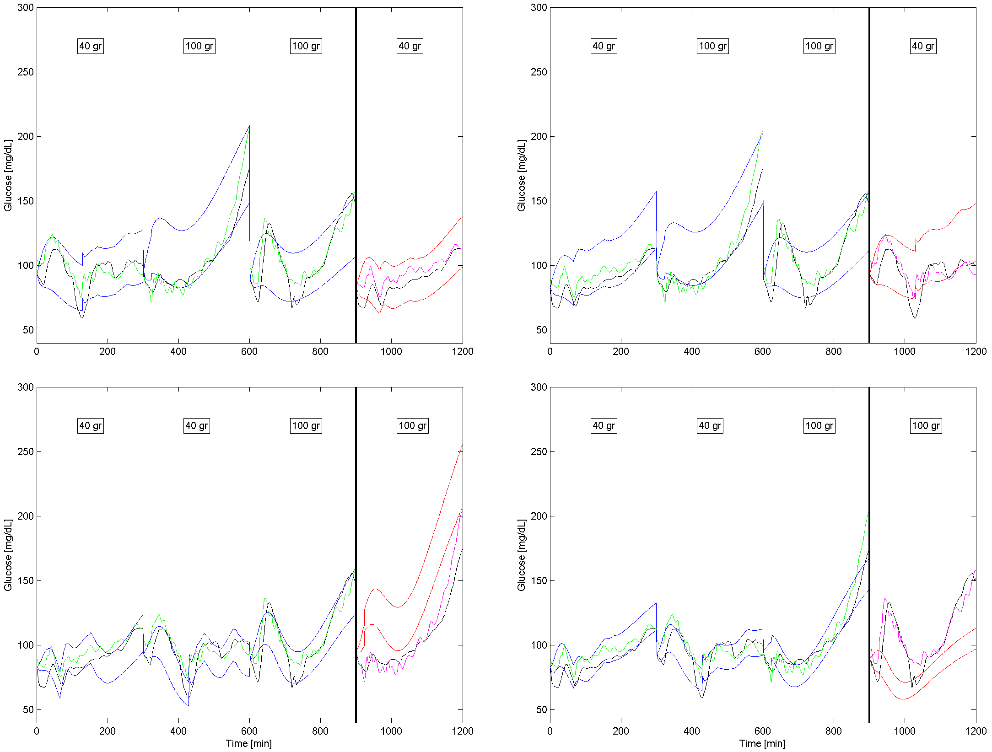
V - CGM Identification
Introduction
State of the art
Objective I
Objective II
Objective III
Conclusions
Patient 6

Slide 40
Identification summary
Introduction
State of the art
Objective I
Objective II
Objective III
Conclusions
 | III - YSI Identification | IV - YSI SCIns Identification | V - CGM Identification
Width [mg/dL] | 66.4 | 72.7 | 85.6
Prediction [%] | 52.8 | 56.8 | 62.5
MARD [%] | 5.56 | 4.3 | 5.14
Env_fit (all data) [mg/dL] | 14.59 | 15 | 19.2
Env_fit (best cases) [mg/dL] | 15.55 | 19.7 | 20
All values are population medians.
Widths increase with the problem’s complexity, for a similar level of predictability.
Independently of the problem’s complexity, interval identification is able to use a particular combination of days to accurate predict the patient’s glucose profile.
Identified widths are always representative of displayed variability.
Notes:
Transparencia clau de la presentació

Slide 41
Conclusions
Introduction
State of the art
Objective I
Objective II
Objective III
Conclusions
Simple home experiments were designed for maximization of the identifiability of T1DM models.
A medical protocol was extracted from the results of the experiment design, and approved by ethical committee of the Hospital Clínic de València.
A statistical model of the error of two commercial CGM devices was designed.
The model is able to reproduce in simulation the basic characteristics of the error signal.
A full cross validation study was performed in real patient data, for different levels of complexity in the model and the information available.
A best case permutation was found for every identification study performed.
Widths in the best case were representative of real patient variability.

Slide 42

Future Work
Introduction
State of the art
Objective I
Objective II
Objective III
Conclusions
Test identification methodology on larger databases.
Expand multi-objective optimization to real patient identification.
Explore possibilities of variability estimation a priori on experimental data. Test the width estimators in home environment.
Validation of protocol of optimal experiment design.
Integrate interval fitness index in the optimization algorithm.
Explore robust control applications of interval predictions.
Include the interval identification methodology in an adaptive environment for future use in artificial pancreas prototypes
Notes:
Emprar optimització mult-objectiu significa superar les dificultats tècniques.

Slide 43
Scientific Production
Introduction
State of the art
Objective I
Objective II
Objective III
Conclusions
Journal papers:
Rossetti P, Ampudia-Blasco F J, Laguna, A J, Revert A, Vehí J, Ascaso, J F, Bondia J. Evaluation of a Novel Continuous Glucose Monitoring-Based Method for Mealtime Insulin Dosing -the iBolus- in Subjects with Type 1 Diabetes Using Continuous Subcutaneous Insulin Infusion Therapy: A Randomized Controlled Trial. Diabetes Technology & Therapeutics (2012), 14(11), 1043-1052.
Laguna A J, Rossetti P, Ampudia-Blasco F J, Vehí J, Bondia J. Postprandial performance of Dexcom® SEVEN® PLUS and Medtronic® Paradigm® Veo™: Modeling and statistical analysis, Biomedical Signal Processing & Control (2013), http://dx.doi.org/10.1016/j.bspc.2012.12.003
Laguna A J, Rossetti P, Ampudia-Blasco F J, Vehí J, Bondia J. Identification of intra-patient variability in the postprandial response of patients with type 1 diabetes, Biomedical Signal Processing & Control (2013), http://dx.doi.org/10.1016/j.bspc.2013.07.003
Laguna A J, Rossetti P, Ampudia-Blasco F J, Vehí J, Bondia J. Experimental blood glucose interval identification of patients with type 1 diabetes, Journal of Process Control (2013), 24(1), 171-181.
Conference papers:
Laguna A J, Rossetti P, Ampudia-Blasco F J, Vehí J, Bondia J. (2010, September). Optimal design for individual model identification based on ambulatory continuous glucose monitoring in patients with type 1 diabetes. UKACC International Conference on Control 2010 (pp. 1-6).
Bondia J, Laguna A J, Rossetti P, Ampudia-Blasco F J, Vehí J. (2011, August). On the Use of Hard/soft Specifications to Deal with Intra-Patient Variability in Postprandial Glucose Control in Type 1 Diabetes. 2011 IFAC World Congress (Vol. 18, No. 1, pp. 8347-8353).
Laguna A J, Rossetti P, Ampudia-Blasco F J, Vehí J, Bondia J. (2012, August). Identification of intra-patient variability in the postprandial response of patients with type 1 diabetes. BMS symposium (50, 1-6).
8 abstracts & posters on international conferences.

Slide 44

Contact:
Alejandro José Laguna Sanz
+34 654473072
allasan@upv.es

